Slide 1

Predicting Cascading Failure Onset in Power Systems: A Comparative Analysis of Decision Tree, SVM, and KNN Models
A Multi-Model Approach for Balancing Accuracy and Interpretability in Critical Infrastructure Risk Management
By: Kaylee Eckelman, Ronia Arabian, Raksha Basiwal

Slide 2

Targeted Industry
Power Systems
This is critical because power outages caused by cascading failures disrupt modern society's functioning. For example, the 2003 North American blackout affected 50 million people for over a week. With growing energy demands, understanding and preventing cascading failures is vital for ensuring reliability and minimizing economic losses.
Can we accurately predict the onset time of cascading failures?
Knowing the onset time helps operators take preventive actions to avoid catastrophic failures.
How effectively can power system topology and initial state data contribute to failure predictions?
This enables faster and more efficient assessments without requiring full failure propagation simulations.

Slide 3

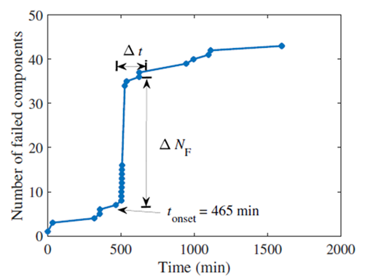
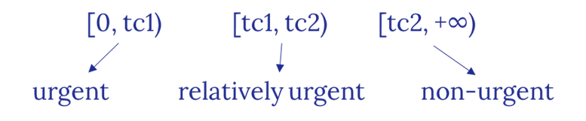
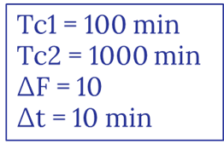
Definition of the onset time
- The main objective here is to predict the onset time of the cascading failure without generating the full profile of failure propagation which requires tim-consuming simulations. - The onset time, defined as the time after which the failure propagation rate increases dramatically, can be identified when the number of failed components, denoted by ∆F during a short enough time duration ∆t.

Slide 4

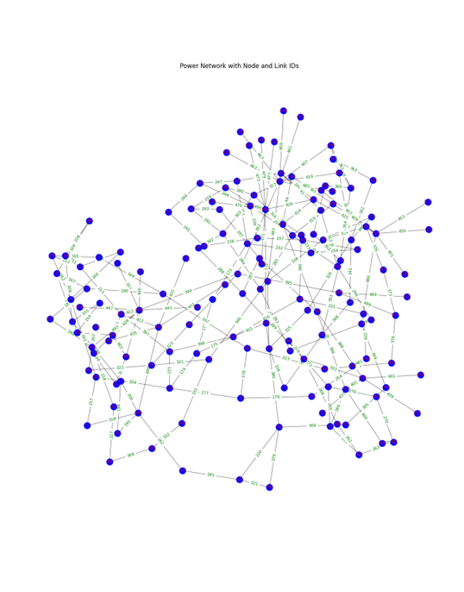

General Info
We use three different classifier to classify the onset time into three different classes in terms of the degree of urgency. (based on length of onset time)
Using 150-Bus UIUC power system network → Synthetic
Includes topological information as well as an adjacency matrix.
The features are obtained by comparing the magnitudes of node and line power before and after a small disturbance, i.e., the k lines that are tripped initially corresponding to the well-known N − k security criteria.
They perform training and testing on the samples generated from the simulations.

Slide 5


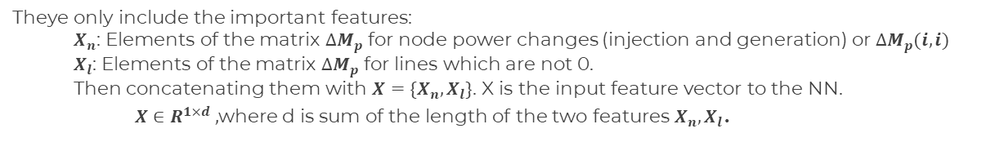
$$∆M_{p}=M_{p,N}−M_{p,N−k}$$
Features construction
𝑴_(𝒑,𝑵) (𝒊,𝒋): Matrix containing the power on each power line. Obtained by power flow calculation after fixing all variables including the admittance matrix, node injected currents and voltages and others.
Non-diagonal elements (i <> j): power between the nodes (on each line)
Diagonal elements (i = j): power injected or generated on each node.
𝑴_(𝒑,𝑵−𝒌) (𝒊,𝒋): The same matrix after removing k power lines and changing the admittance matrix and other variables accordingly.
Theye only include the important features:
$X_{n}$: Elements of the matrix $∆M_{p}$ for node power changes (injection and generation) or $∆M_{p}(i,i)$
$X_{l}$: Elements of the matrix $∆M_{p}$ for lines which are not 0.
Then concatenating them with $X=\{X_{n}, X_{l}\}$. X is the input feature vector to the NN.
$X∈R^{1×d} ,$where d is sum of the length of the two features $X_{n}, X_{l}$.
Vectorized form of the features which also includes the effect of the adjacency matrix

Slide 6

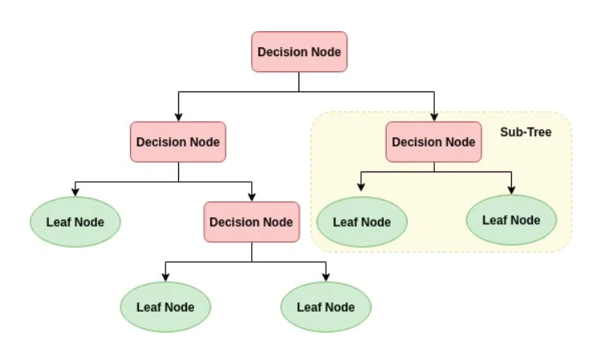
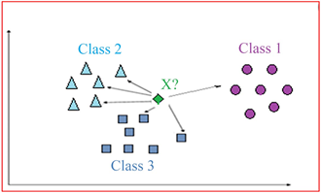
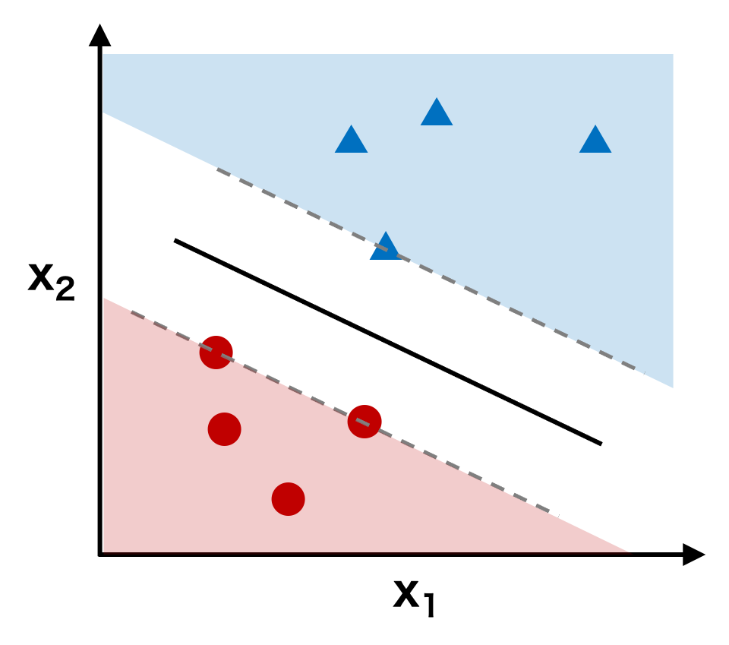
Model Construction
We chose classification model for our problem as we are trying to efficiently categorize failure onset times into Urgent, Relative Urgent, and Non-Urgent classes.
Easy to Understand and Visualize
Able to handle complex data patterns
Non- linear Decision Boundaries
Decision Tree
Adaptability to new data
Low Training Time
Works well with High Dimensionality
KNN
Classification Suitability
High-Dimensional Handling
Robust to Overfitting
SVM

Slide 7

Model Evaluation
Evaluation Metrics for the Models
Accuracy: The overall proportion of correctly predicted instances across all classes.
Precision (per class): The number of true positives for each class divided by the number of instances predicted as that class. It shows the reliability of predictions for each class.
Recall (per class): The number of true positives for each class divided by the actual number of instances in that class. It reflects the model’s ability to identify each class correctly.
F1-Score: The harmonic mean of Precision and Recall for each class. A balanced measure when Precision and Recall need to be optimized together.
Confusion Matrix: Helps visualize the misclassifications between the classes.
Key Takeaways:
Decision Tree (Baseline): Good starting point with 70% accuracy.
KNN: Provides slight improvement in accuracy (72%).
SVM: Outperforms both Decision Tree and KNN, achieving an 84% accuracy, indicating it’s the most effective model amongst these three for predicting cascading failure onset times in this multi-class classification task.

Slide 8

Model Results & Insights
Decision Tree
KNN Classifier
SVM Classifier
Accuracy: 70%
Key Insight: Provides interpretable decision paths, highlighting critical factors (e.g., power flow differences) driving cascading failures.
Use Case: Identify high-risk nodes and lines quickly.
Accuracy: 72%
Key Insight: Achieved slightly better accuracy than the Decision Tree but lacks interpretability.
Use Case: Confirms predictions but less effective for actionable insights.
Accuracy: 84%
Key Insight: Models complex decision boundaries with the highest accuracy among the three models.
Use Case: Ideal for high-stakes scenarios requiring precise predictions.

Slide 9

Business Value & Recommendations
Answering the Proposed Questions
Prediction of Onset Time: Models classify cascading failure urgency effectively, enabling focus on critical scenarios.
Critical Features: Decision Tree identifies power flow differences as key drivers of failures, offering actionable insights.
Business Value
Decision Tree: Clear interpretability for identifying high-risk areas and prioritizing interventions.
SVM: Highest accuracy (84%) for reliable predictions in critical, high-stakes scenarios.
KNN: Supports validation of predictions but lacks interpretability.
Recommendations
Deploy SVM for critical decision-making scenarios requiring high accuracy.
Use Decision Tree for interpretability and actionable insights to mitigate risks.
Integrate Both Models into a unified real-time system for grid stability.
Validate with real-world data and explore ensemble methods for balanced performance.

Slide 10
References
Fang, W., Yan, J., & Liu, Z. (2022).
Predicting Onset Time of Cascading Failure in Power Systems Using a Neural Network-Based Classifier.

